Slide 1

Managing Fire: wildfire prevention by gathering data, informing and training local communities
Team members: Nikoloz Mujirishvili, Alexandre Zaalishvili, Irakli Oqropiridze, Giorgi Sidamonidze, Luka Tavartqiladze

Slide 2
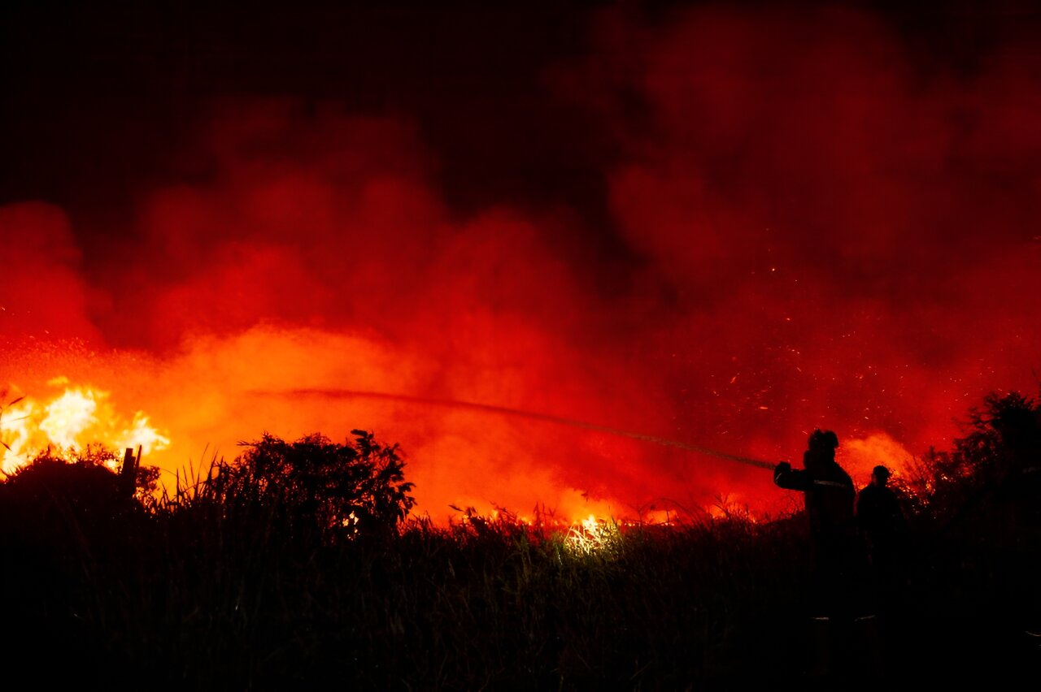
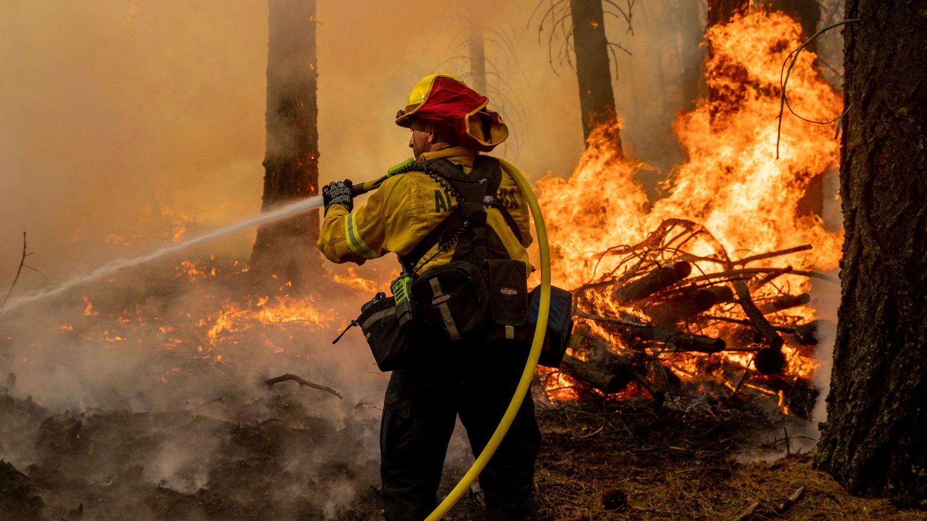
Colorado
Chile

Slide 3
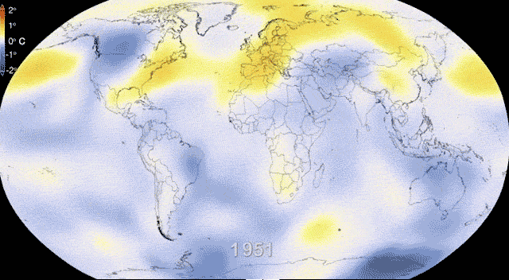

Slide 4
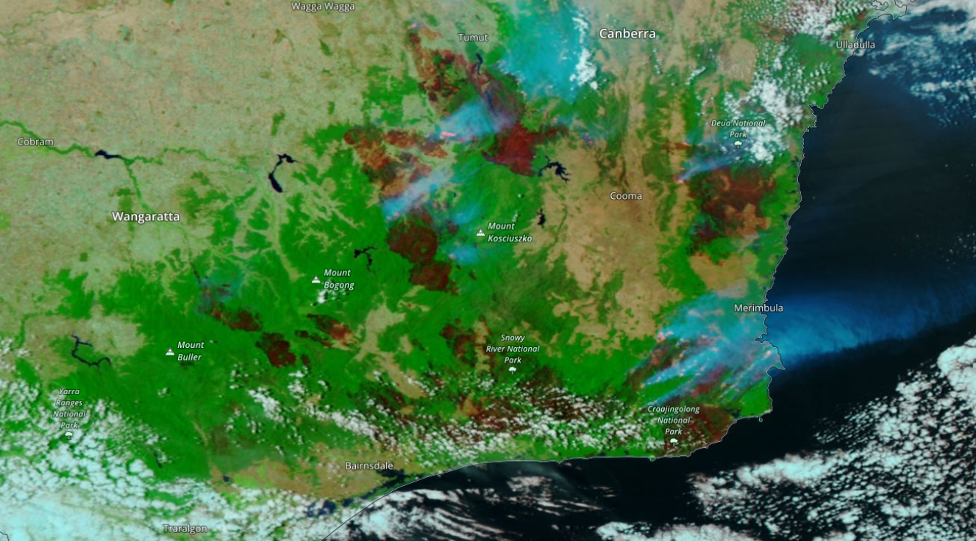
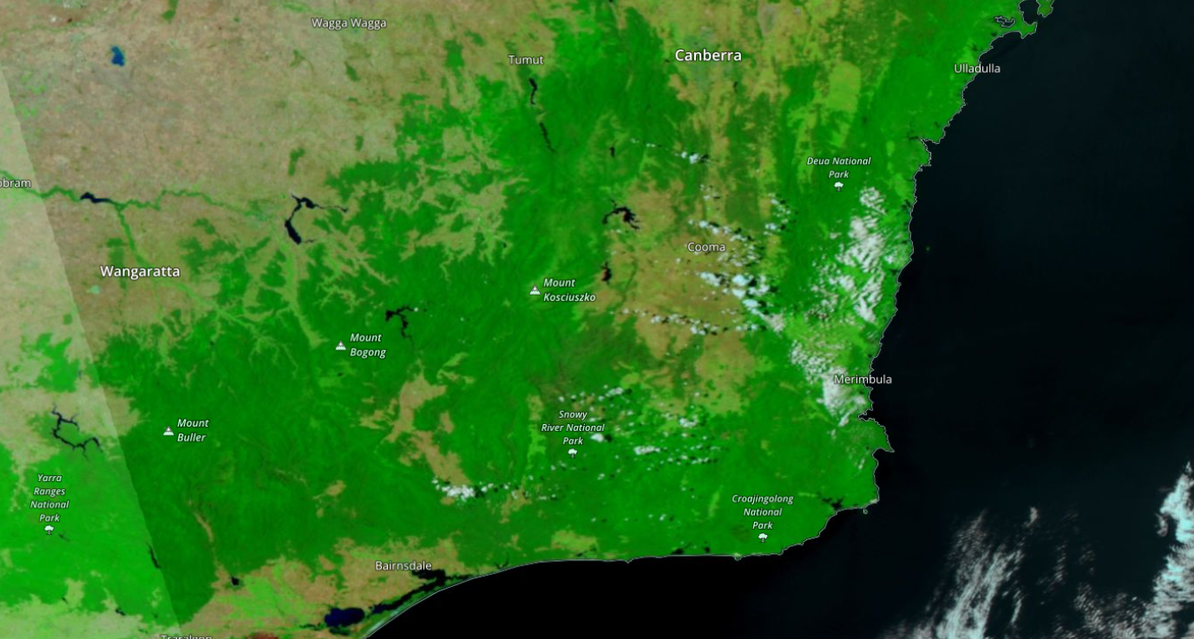
Australian Bushfire Jan 2020
Australian Bushfire Jan 2019

Slide 5
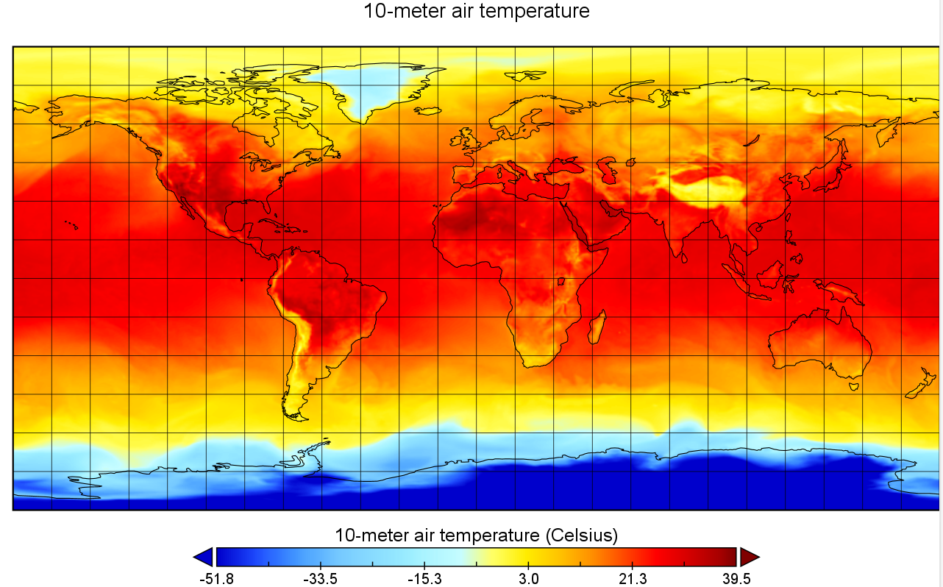


Slide 6
Fire Prevention Database
Satellite Images
Regional Climate Trends
Thermal sensors
Local Sources
we will help to inform the locals and provide assistance to the experts in the field

Slide 7
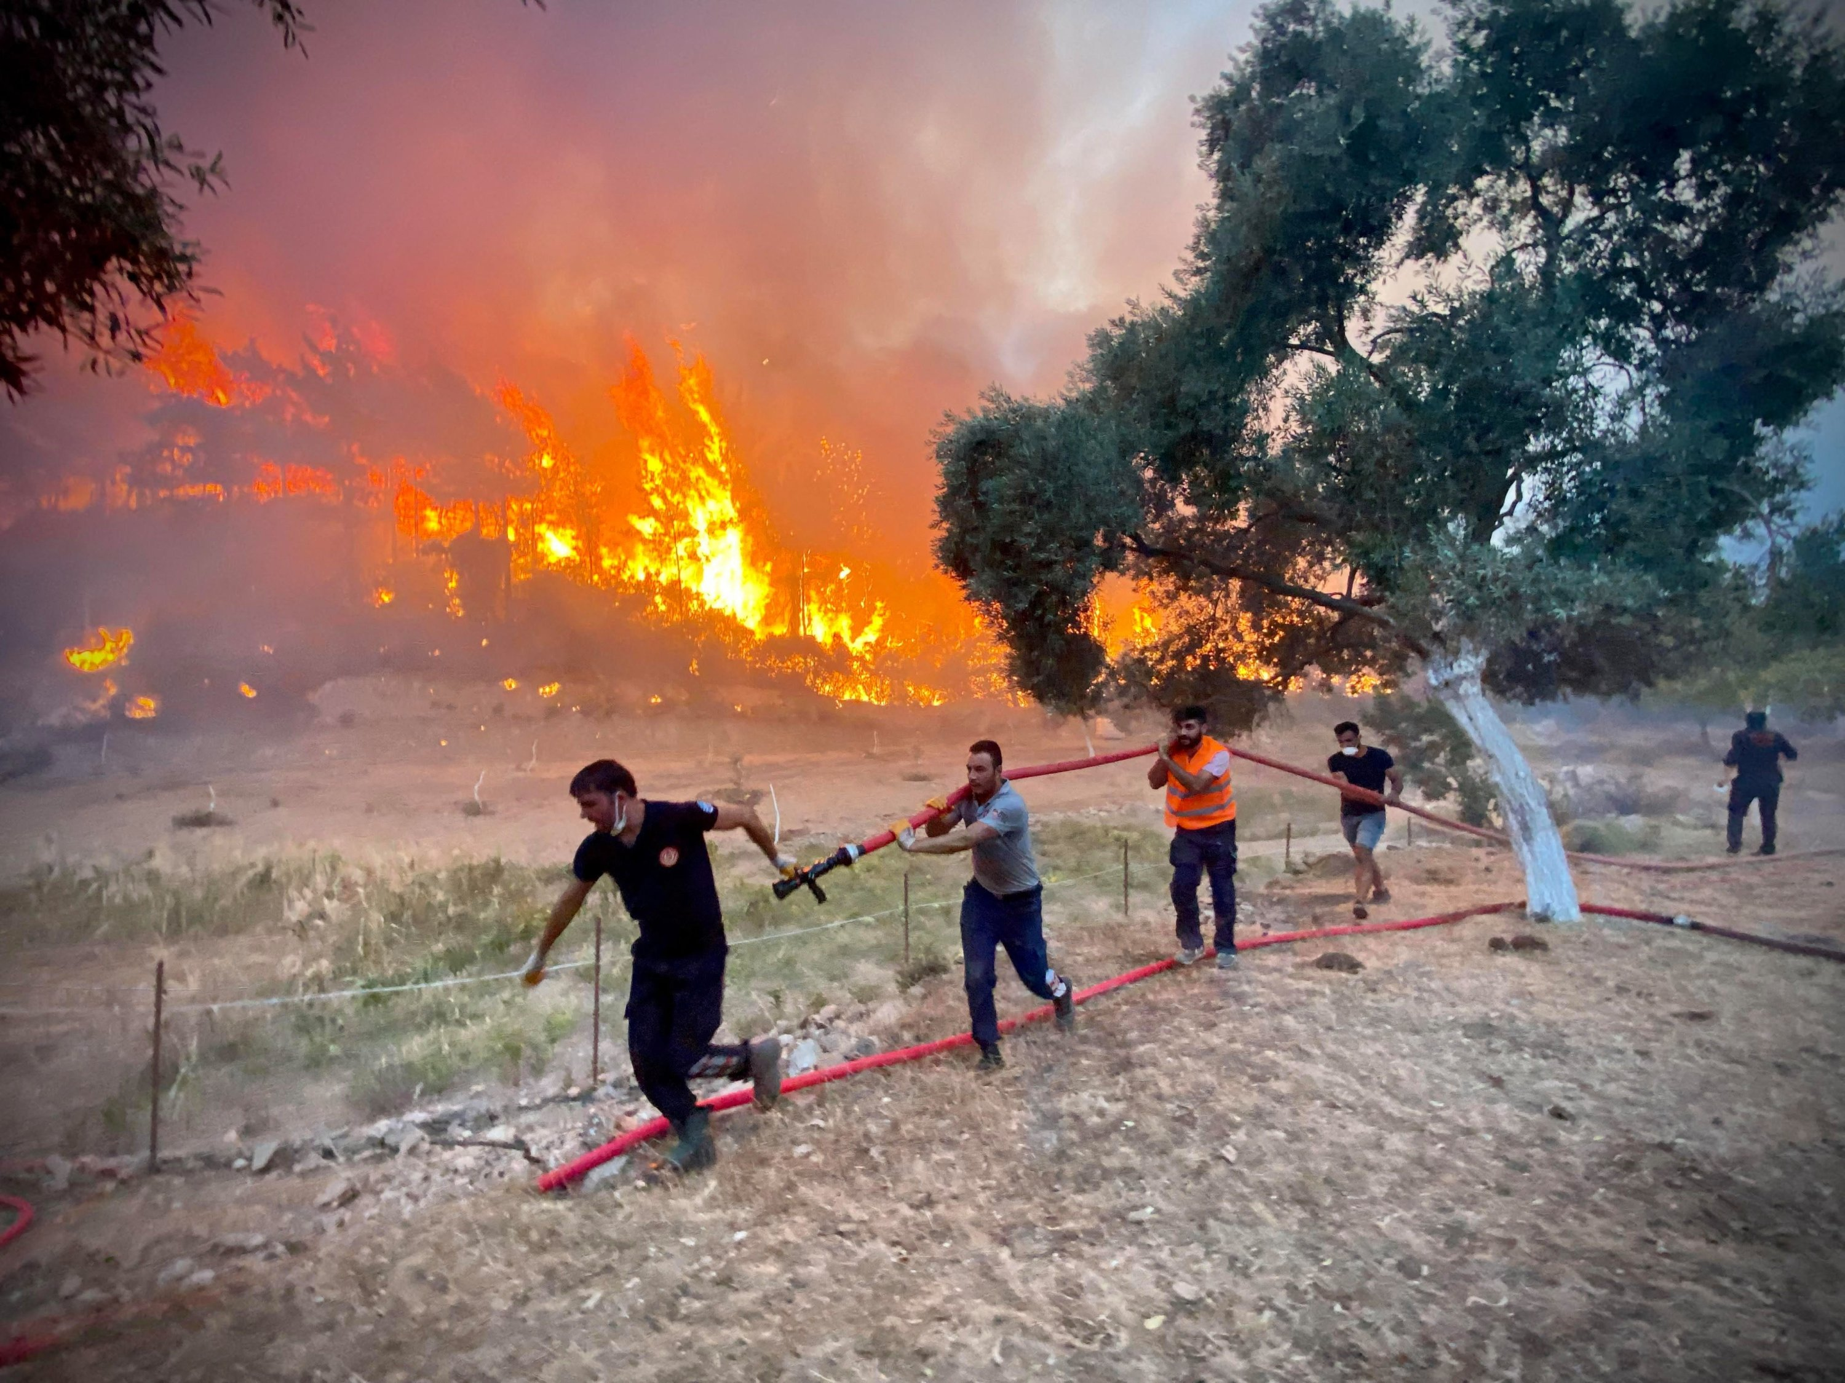

Slide 8
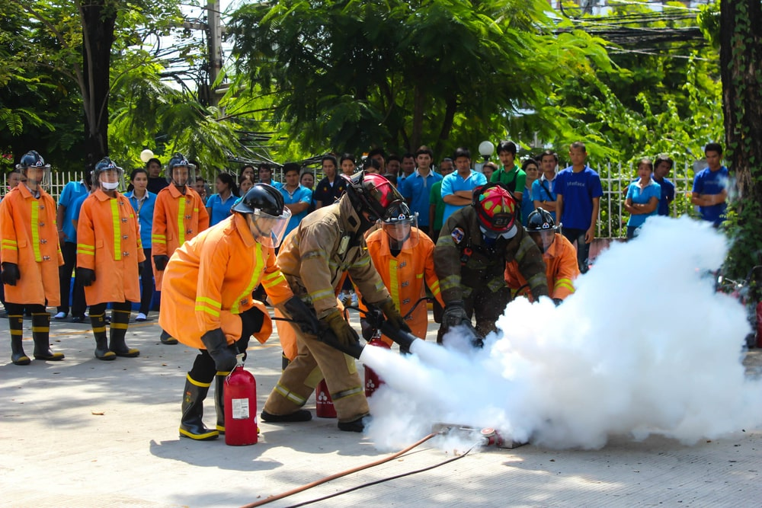

Slide 9
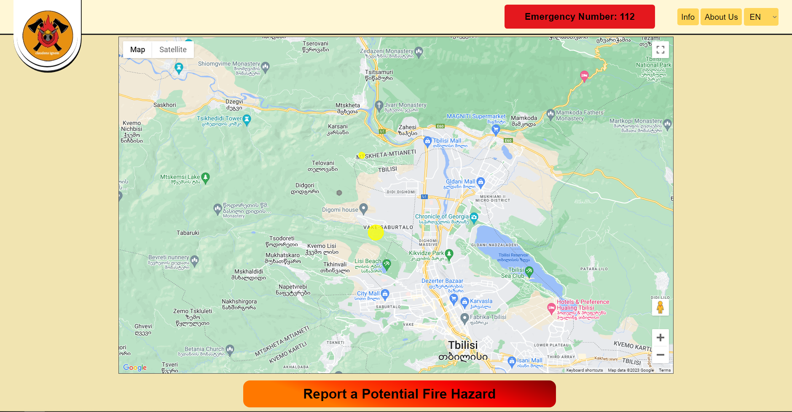

Slide 10

Thank you for your attention

